Slide 1
Computational thinking group project
G22_T6
REISHAV KRISHNA GUPTA
TAN JUN SHENG JACKSON

Slide 2
TABLE OF CONTENTS
01
Our algorithm
02
Big-o time complexity
03
Contribution
You can describe the topic of the section here
You can describe the topic of the section here
You can describe the topic of the section here

Slide 3
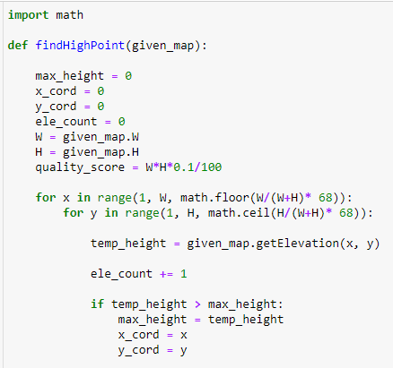
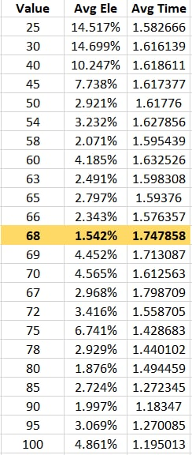
OUR ALGORITHM - PART 1
OUR ALGORITHM
BIG-O TIME COMPLEXITY
CONTRIBUTIONS
Brute Force Search
1. Initializing variables:
max_height, x_cord, y_cord -> temporary variables for maximum point/height
ele_count / quality_score -> number of times get_elevation is called and can be called.
2. Scan through map in steps:
Nested For Loop to scan through X and Y coordinates of the map, in steps of <value calculated based on W/H ratio + a constant derived from trial and error>. We generated 5 more test maps to avoid overfitting to provided maps
For every increment, compare the height of current coordinate to that of the previous highest point. If it is higher, set current coordinate as highest point.

Slide 4
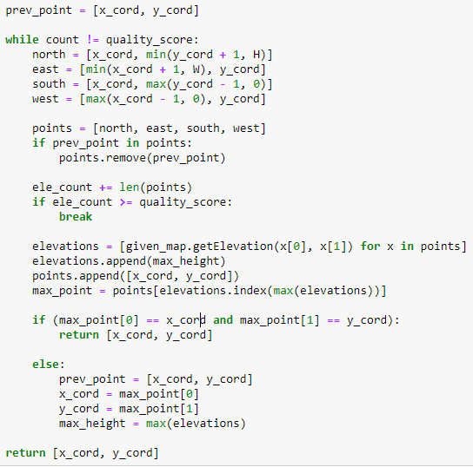
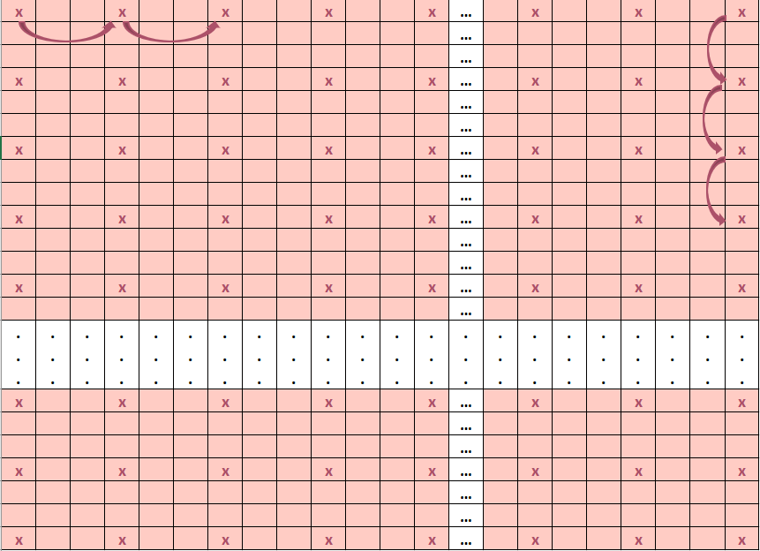
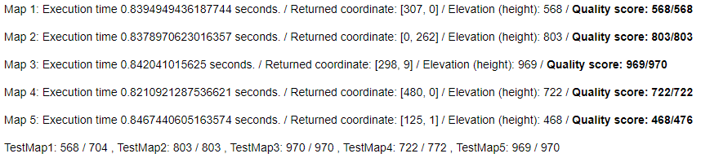
OUR ALGORITHM - PART 2
OUR ALGORITHM
BIG-O TIME COMPLEXITY
CONTRIBUTIONS
Navigation
1. While Loop:
To make sure that the code doesn’t call get_elevation more times than the limit allows.
North
West
East
Remove previous point so as to prevent going back to it if current point and previous point are the same height
South
2. Checking the surrounding points:
Check the points one coordinate to the north, east, south, and west direction of the highest point so far. Compare them to find the highest point among them, setting it to the variable max_point.
North
East
South
3. If scenario where height is the same:
If height is the same, the surrounding coordinates will take priority over current coordinates (due to order of list), so as to increase the odds of finding the highest point.
4. Return Function
If current point is the highest, function returns current point. Else, we will move to the next point and continue our search until we find the highest point.

Slide 5
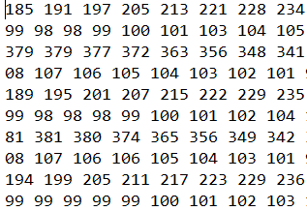
BIG-O TIME COMPLEXITY
OUR ALGORITHM
BIG-O TIME COMPLEXITY
CONTRIBUTIONS
Method #1
Method #2
For a given map of dimensions W x H, we specify the maximum number of operations to be:
0.01 % x W x H
So for a 1000 x 1000 map,
# operations = 0.01% x 1000²
As W, H → ∞
Big-O complexity = O(WH)
A map can be thought of as a W x H grid

Slide 6


THIS FOR CONTRIBUTION SLIDE?
Tan jun sheng jackson
Carlos reishav gupta
Algorithm Concept and Coding
Code Explanation
Algorithm Testing
Test map generation
Increment value derivation
Big-O complexity derivation

Slide 7
THANK YOU!

